Slide 1

Globally Solving the Gromov-Wasserstein Problem for Point Clouds in Low Dimensional Euclidean Spaces
Lovera Lokeswara
SID. 20798275
Notes:
Find a pic

Slide 2

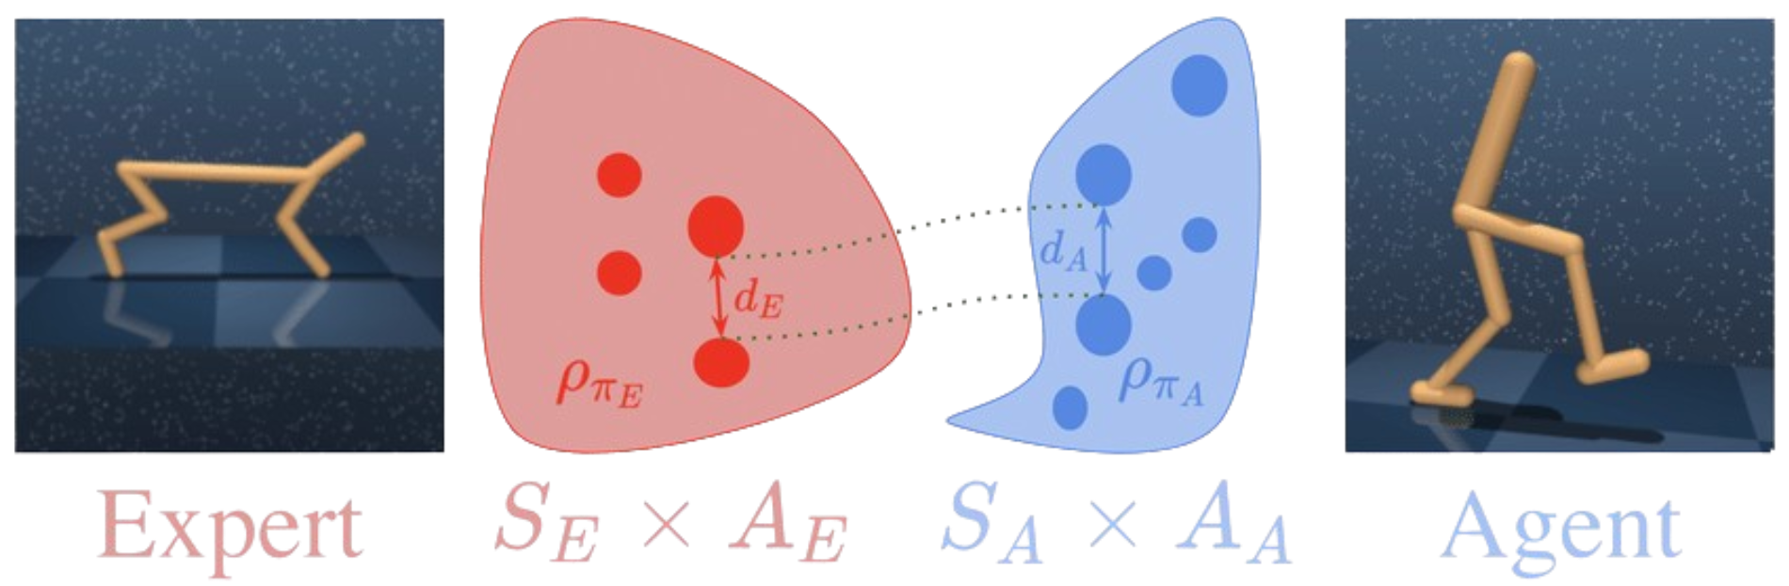

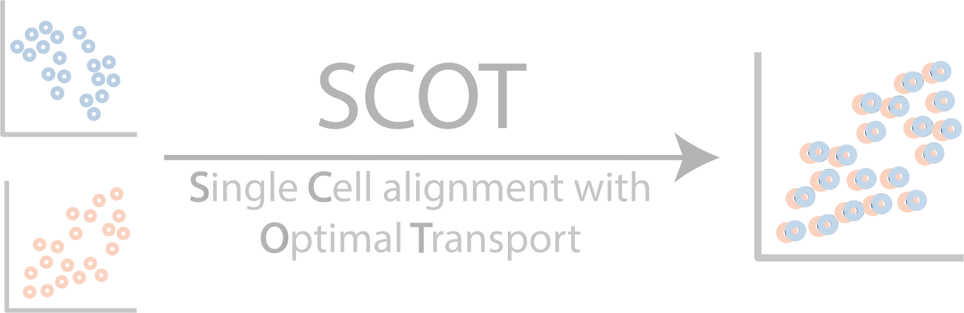

Project Background
Introduction - Overview
AUTHORS
MAIN PROBLEM
POSSIBLE APPLICATION
MAIN ALGORITHM
Gromov-Wasserstein
Intractable with exponentially increasing computational burden
Gromov - Wasserstein
GWIL
Gromov-Wasserstein Imitation Learning
Martin Ryner
Quadratic Assignment Problem (QAP)
NP-Hard
Optimal transport problem that finds the assignment between 2 sets while preserving the pairwise distances as much as possible
Jan Kronqvist
Low-Rank QAP
Cutting Plane Algorithm
SCOT
Single Cell Alignment with Optimal Transport
Johan Karlsson
Introduction | Algorithm | Experiment | New Development
Notes:
Change this

Slide 3
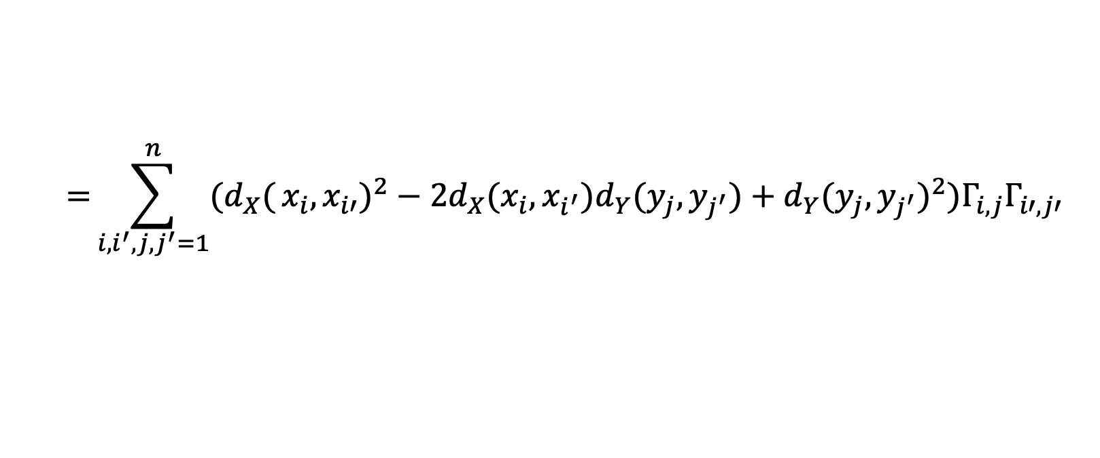

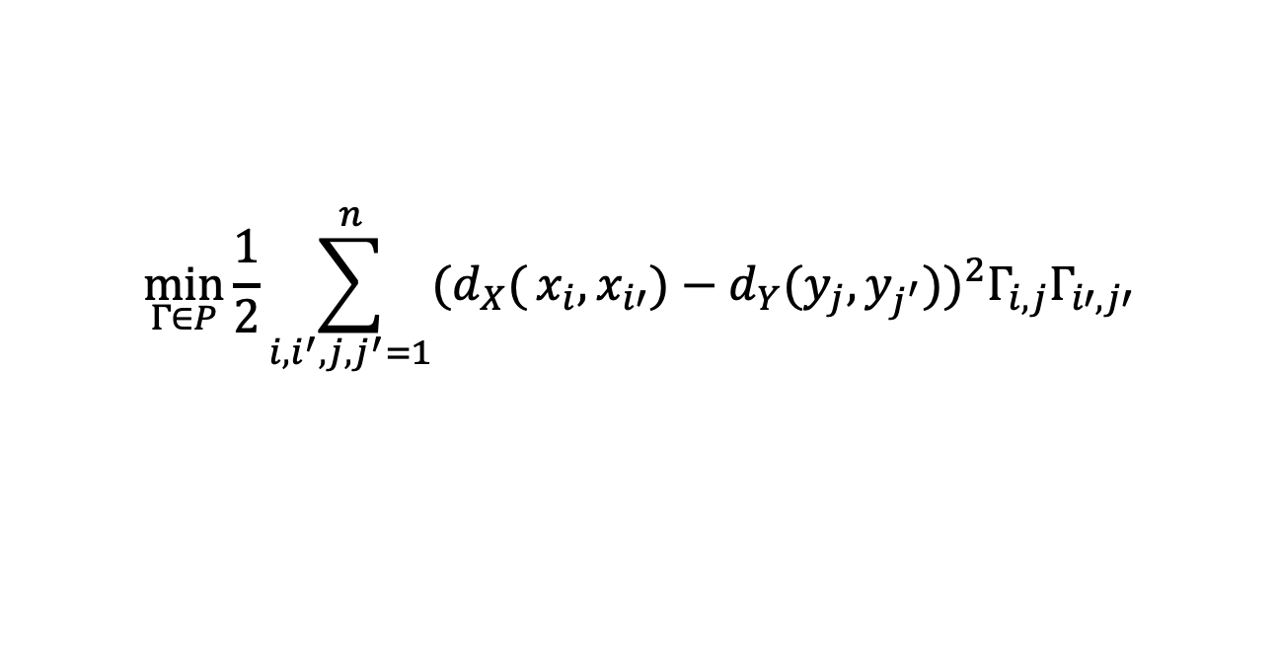
Gromov-Wasserstein → QAP
Introduction - Problem Set Up
Let $x_{1},…,x_{n}∈X$ and $y_{1},…,y_{n}∈Y$be 2 sets of points. The problem is to find an assignment $π$ that minimizes this:
$$\min_{Γ∈P}{\frac{1}{2}\sum_{i,i^{′},j,j^{′}=1}^{n}{(d_{X}(}}{x_{i},x_{i′})−{d_{Y}(y}_{j},y_{j^{′}}))}^{2}Γ_{i,j}Γ_{i′,j′}$$
$$={\sum_{i,i^{′},j,j^{′}=1}^{n}{(d_{X}(}}{x_{i},x_{i′})^{2}−2d_{X}(x_{i},x_{i^{′}}){d_{Y}(y}_{j},y_{j^{′}}){ +{ d}_{Y}(y}_{j},y_{j^{′}})}^{2})Γ_{i,j}Γ_{i′,j′}$$
$$= \left\langle C_{x},C_{x}\right\rangle −2\left\langle C_{x}Γ,ΓC_{y}\right\rangle +\left\langle C_{y},C_{y}\right\rangle$$
$$\min_{Γ∈P}{ −\left\langle C_{x}Γ,ΓC_{y}\right\rangle +\frac{1}{2}\left(\left\langle C_{x},C_{x}\right\rangle +\left\langle C_{y},C_{y}\right\rangle \right)}$$
Where Cx and Cy are the Euclidean distance matrix, so they are positive definite and low-rank matrices
This problem is a QAP of rank (𝑙_{𝑥}+2)(𝑙_{𝑦}+2)
Introduction | Algorithm | Experiment | New Development

Slide 4
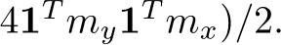
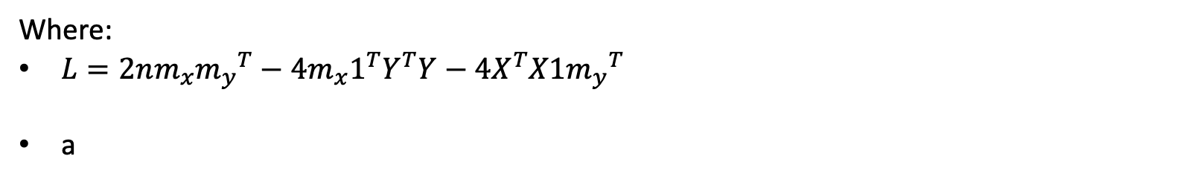
Reducing the Rank (𝑙𝑥+2)(𝑙𝑦+2) → 𝑙𝑥𝑙𝑦
Introduction - Problem Set Up
Substitute $\left\langle C_{x}Γ,ΓC_{y}\right\rangle$ to the previous equation (Proposition 1.)
Where $L=2nm_{x}{m_{y}}^{T}−4m_{x}1^{T}Y^{T}Y−4X^{T}X1{m_{y}}^{T}$
Low rank formulation of Gromov-Wasserstein
Where:
$L=2nm_{x}{m_{y}}^{T}−4m_{x}1^{T}Y^{T}Y−4X^{T}X1{m_{y}}^{T}$
a
Introduction | Algorithm | Experiment | New Development

Slide 5
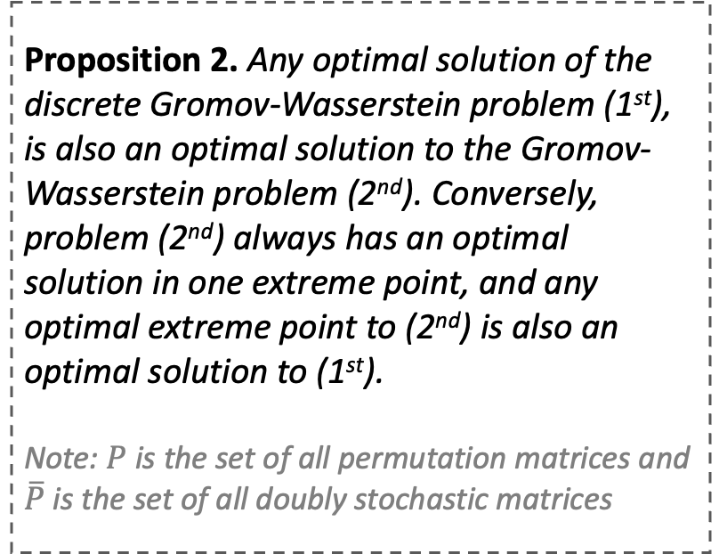
Relax the Problem
Introduction - Problem Set Up
Proposition 2. Any optimal solution of the discrete Gromov-Wasserstein problem (1st), is also an optimal solution to the Gromov-Wasserstein problem (2nd). Conversely, problem (2nd) always has an optimal solution in one extreme point, and any optimal extreme point to (2nd) is also an optimal solution to (1st).
Note: $P$ is the set of all permutation matrices and $\overline{P}$ is the set of all doubly stochastic matrices
Cutting Plane Algorithm: Solve a sequence of relaxed problems that are iteratively strengthened by generating and accumulating valid linear inequality constraints
Cutting Plane Algorithm
Introduction | Algorithm | Experiment | New Development

Slide 6
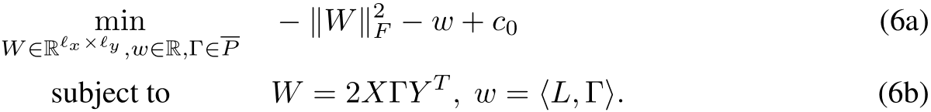
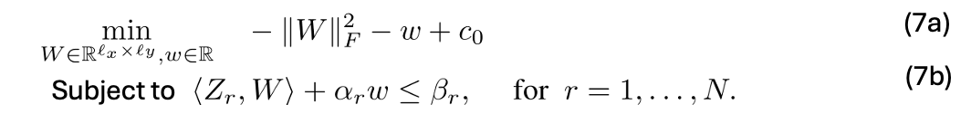
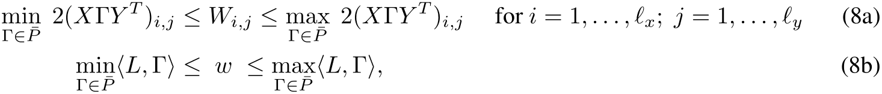
Algorithm Set Up
Algorithm
Objective
Build the world’s best company and …
Start of Algorithm
Title
1
Create new variables for better analysis
Title
2
Project out the 𝚪 variables, and we define the feasible set polytope 𝓕
Title
3
A bounding box 𝓕 to define the set of constraints
Introduction | Algorithm | Experiment | New Development

Slide 7
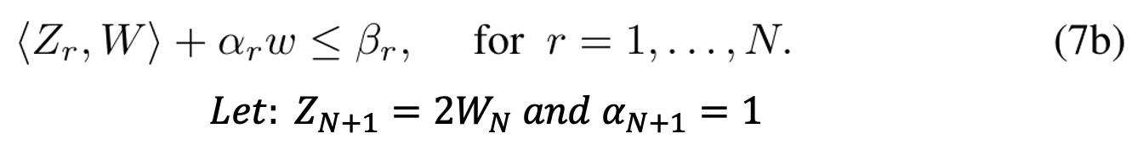
Algorithm Set Up
Algorithm
Objective
Build the world’s best company and …
Title
4
Construct new constraint based on the gradient of the objective function (7)
Title
5
New constraint that bound 𝓕
Title
6
Update the Upper Bound
End of Algorithm
Introduction | Algorithm | Experiment | New Development

Slide 8
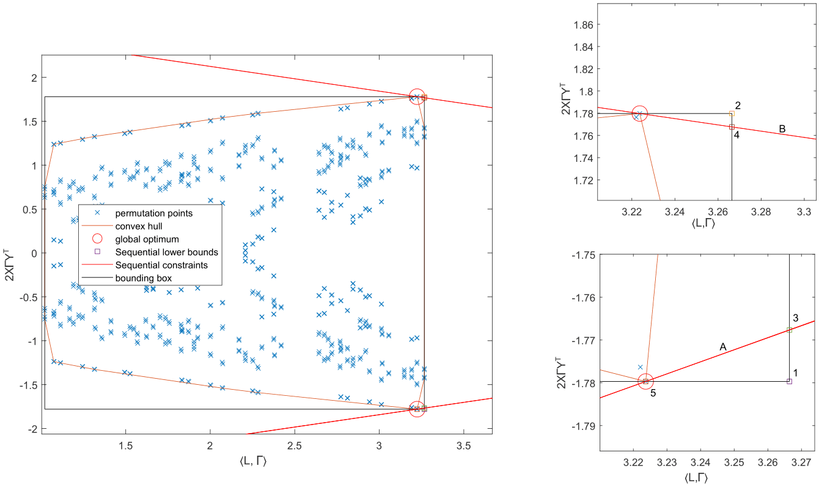

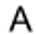
Visualization
Algorithm
Introduction | Algorithm | Experiment | New Development

Slide 9
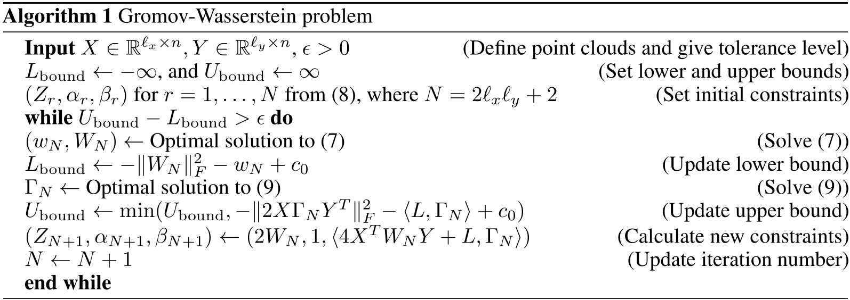
Visualization
Algorithm
Pseudocode
Introduction | Algorithm | Experiment | New Development

Slide 10

Convergence
Algorithm
Proving the convergence of the algorithm
Updating Lower Bound
Theorem
The gap between the upper bound and lower bound in this algorithm will converge to 0 (if the tolerance is ϵ = 0)
LBound ←$−{\left\|W_{N}\right\|}_{F}^{2}−w_{N}+ c_{0}$
Updating Upper Bound
UBound ← $\min{(UBound, −{\left\|2XΓ_{N}Y^{T}\right\|}_{F}^{2}−\left\langle L,Γ_{N}\right\rangle +c_{0})}$
Introduction | Algorithm | Experiment | New Development

Slide 11
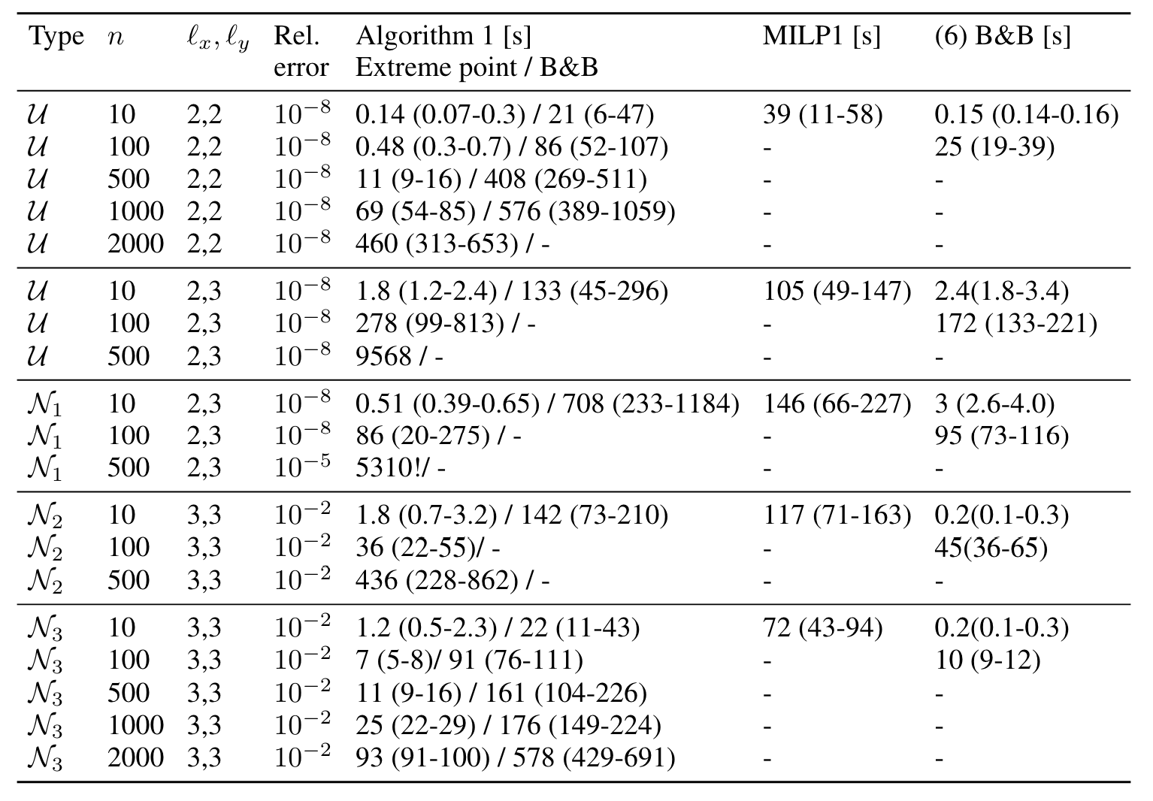
Numerical Experiment Result
Experiment
Algorithm 1 =
Proposed Algorithm
1
MILP 1
2
Branch & Bound
3
Introduction | Algorithm | Experiment | New Development
Notes:
Using Matlab on an Intel i5 2.9 GHz P
Solve problem (9) using a std package based on network simplex model

Slide 12
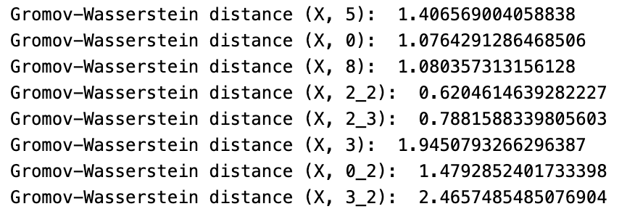
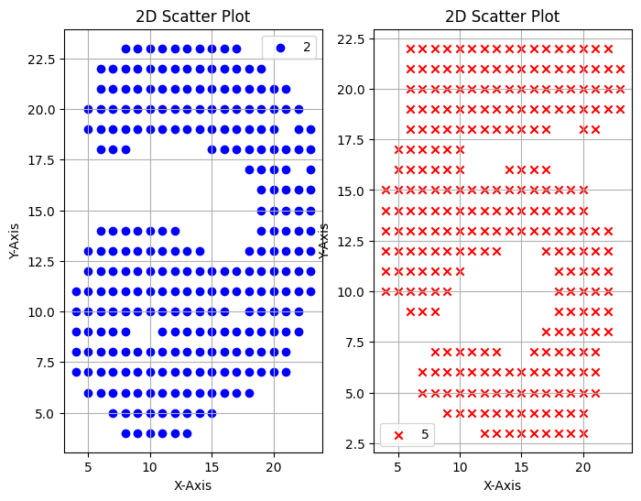
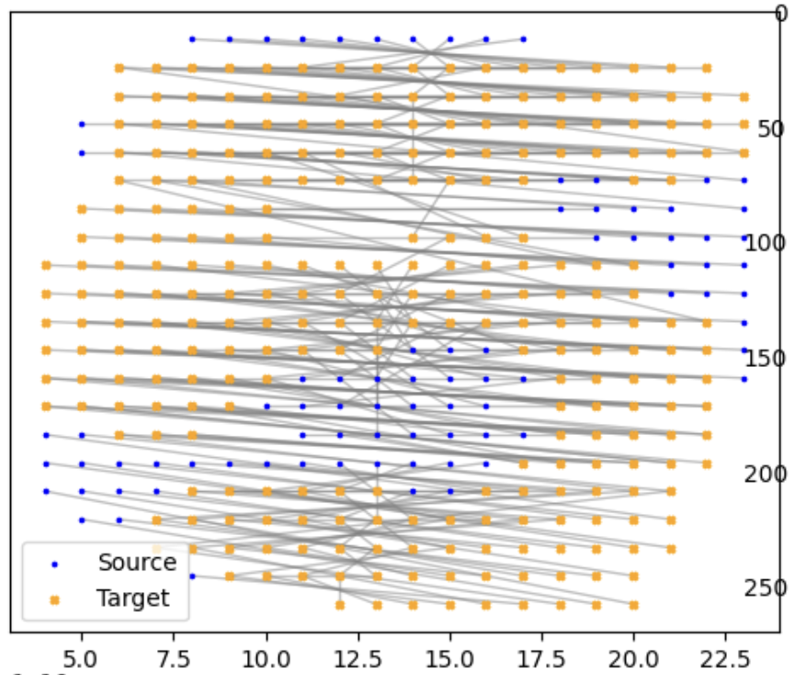
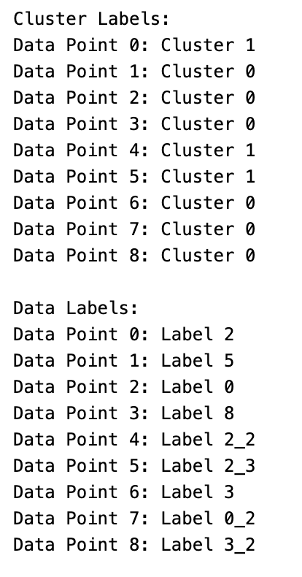
MNIST Dataset
New Development
Stage 1: Pre-process the Dataset
Stage 2: Compute the best assignment
Stage 3: Calculate GW Distance and use K-means clustering (k=2)
Content 2 (16 pt)
Dataset Source: https://www.kaggle.com/datasets/cristiangarcia/pointcloudmnist2d?select=test.csv
Introduction | Algorithm | Experiment | New Development
Stage 1
Stage 2: xx years into the JV

Slide 13

Algorithm Modification
New Development
Adaptive Epsilon
Scaled EMD
Do not need high precision in early iteration.
Faster convergence in early iterations.
Later iterations might benefit from stricter convergence criteria.
Reduce computational cost while maintaining solution quality.
Linear programming solvers work better with well-conditioned matrices.
Prevents numerical overflow or underflow.
Improves the numerical stability.
Maintain solution accuracy through proper rescaling and better conditioning of the optimization problem.
Introduction | Algorithm | Experiment | New Development

Slide 14
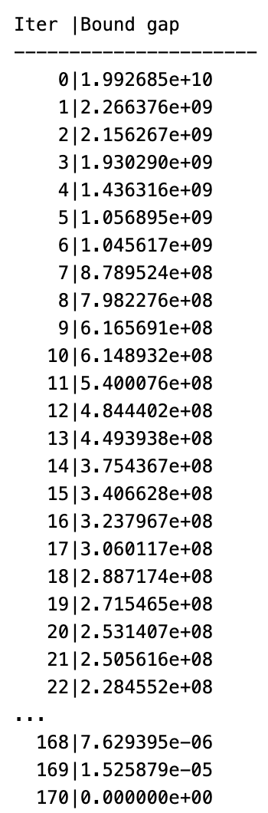

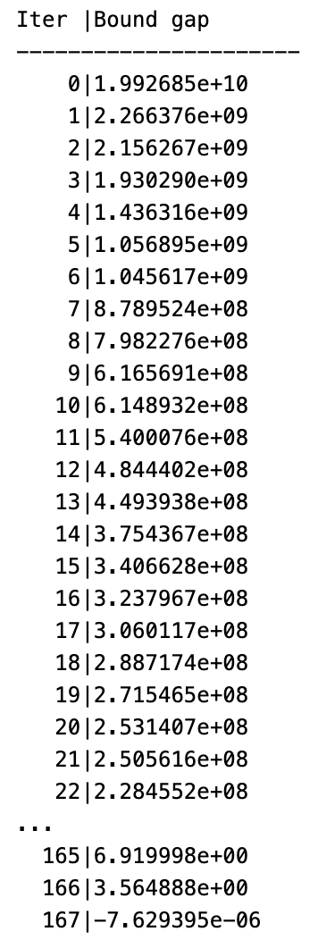
Algorithm Modification – Early Stopping and Scaled EMD
New Development
Original Algorithm – MNIST Data
Modified Algorithm – MNIST Data
Use a fixed epsilon for convergence
EMD solver can face numerical issues with very large or small values
Use adaptive epsilon for convergence
Prevents numerical overflow or underflow
Source: https://www.kaggle.com/datasets/cristiangarcia/pointcloudmnist2d?select=test.csv
Introduction | Algorithm | Experiment | New Development

Slide 15
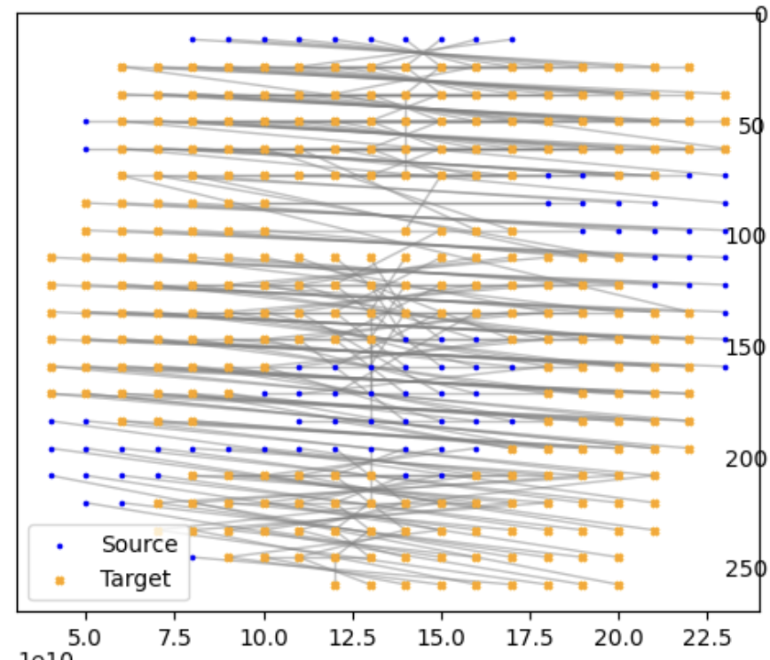
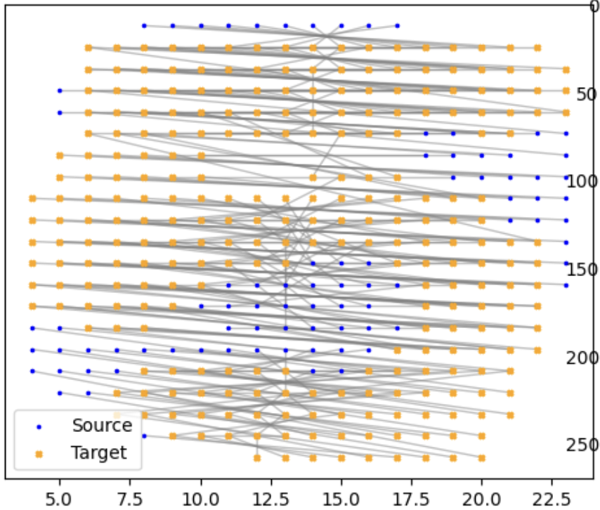
Algorithm Modification – Early Stopping and Scaled EMD
New Development
Original Algorithm – MNIST Data
Modified Algorithm – MNIST Data
Use a fixed epsilon for convergence
EMD solver can face numerical issues with very large or small values
Use adaptive epsilon for convergence
Prevents numerical overflow or underflow
Obtain the same solution with less iteration !!!
Source: https://www.kaggle.com/datasets/cristiangarcia/pointcloudmnist2d?select=test.csv
Introduction | Algorithm | Experiment | New Development

Slide 16
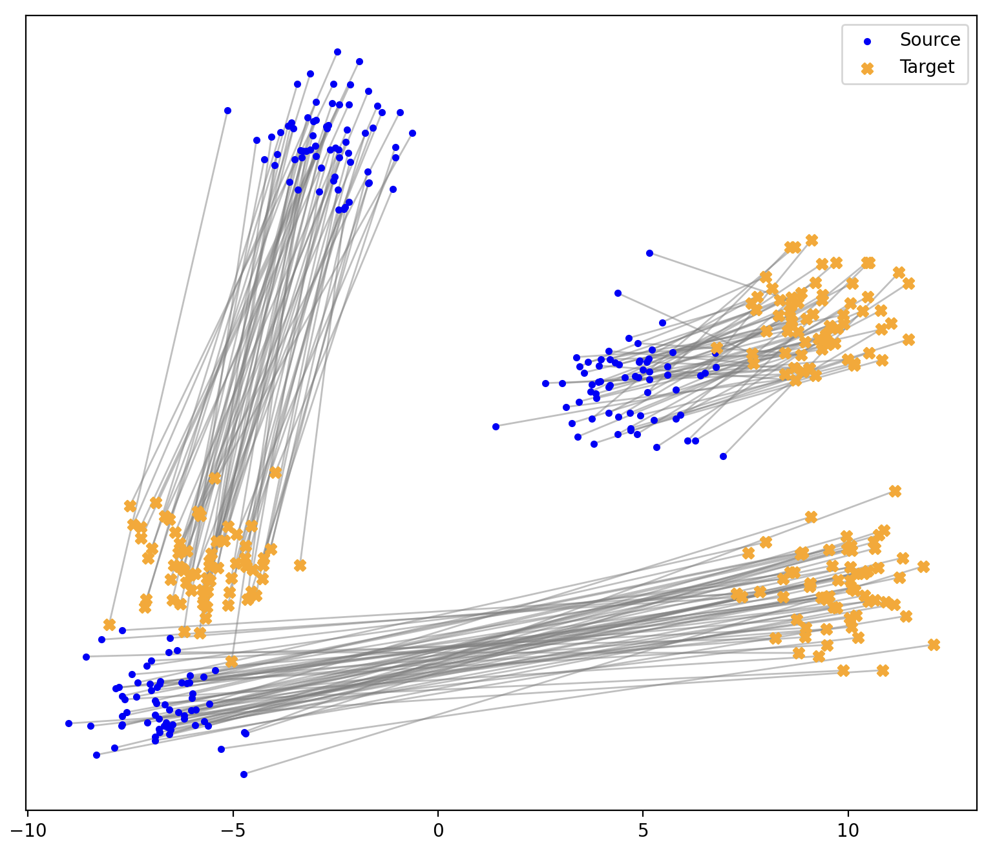

Algorithm Modification – Early Stopping and Scaled EMD
New Development
Original Algorithm – Artificial Data
Modified Algorithm – Artificial Data
Obtain the same solution with less iteration !!!
Source: Synthetic Data
Introduction | Algorithm | Experiment | New Development

Slide 17
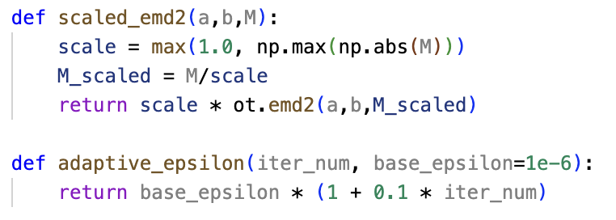
Algorithm Modification – Early Stopping and Scaled EMD
New Development
Modified Algorithm – Pseudocode
Introduction | Algorithm | Experiment | New Development

Slide 18



Key takeaway
The modified algorithm gives us the same global optimal solution
The modified algorithm needs less iteration.
Notes:
Gromov-Wasserstein Problem is useful, this algorithm is great for problems that requires the global optimal solution and can find it in reasonable time. The experiment is a proof that the modification 1 is great and requires less iteration. The 2nd modification does not necessarily give the global maximum solution, but it is definitely faster to suit more theoretically with the EMD set up.

Slide 19

Thank you!
____________
Code can be found here: https://github.com/LoveraLokeswara/Gromov_Wasserstein_for_Low_Dimension

Slide 20
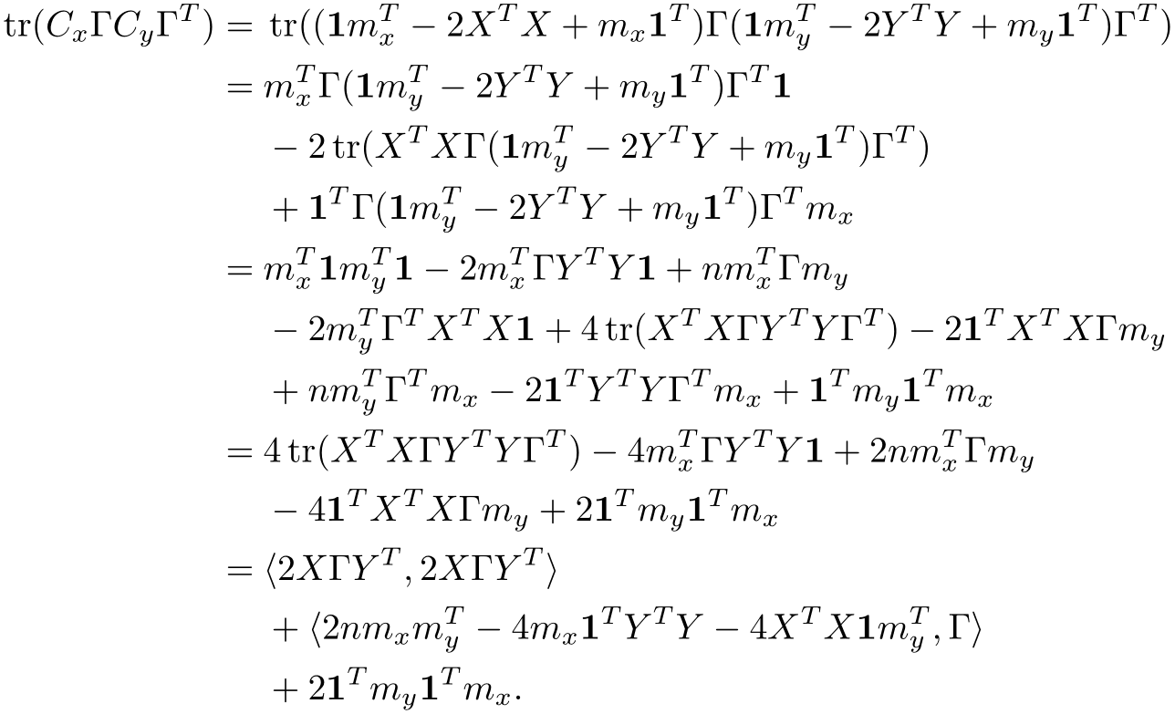
Proof of Proposition 1
Appendix
Proof
Appendix

Slide 21
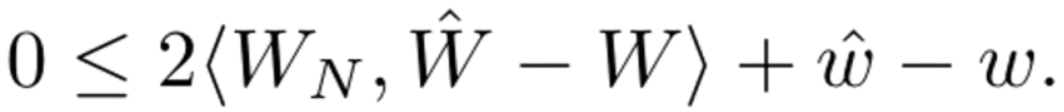
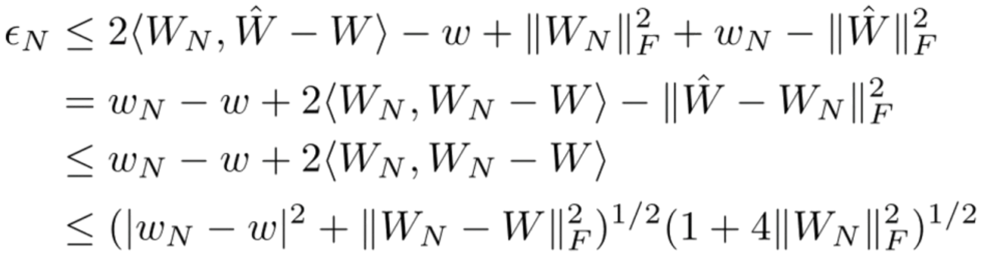
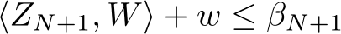
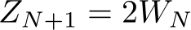
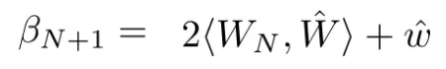
Proof of Theorem 1
Appendix
The gap between the upper bound and lower bound in this algorithm will converge to 0 (if the tolerance is ϵ = 0)
Let (w_{N}, W_{N}) = optimal solution to (7)
𝚪_{N} = optimal solution to (9) with corresponding points $\left(\hat{w},\hat{W}\right)=(\left\langle L,\text{Γ}\text{N}\right\rangle , 2X{\hat{\text{Γ}}}_{N}Y^{T})$
$${\text{ε}}_{N}=UBound −LBound$$
$${\text{ε}}_{N}={\left\|W_{N}\right\|}_{F}^{2}−w_{N}−{\left\|\hat{W}\right\|}_{F}^{2}−\hat{w}$$
The new constraint is
Where and
$$\frac{ε}{{(1+4\max\left\{{\left\|W\right\|}_{F}^{2} \right| W∈(8)\})}^{1/2}}≤{({\left|w_{N}−w\right|}^{2}+{\left\|W_{N}−W\right\|}_{F}^{2})}^{1/2}$$
Appendix

